Slide 1
Design and Implementation of a Web Based Prescription Systems
Presented By Md. Mineuddin Ahmed Dipu ID: CSE202103099 Department of Computer Science and Engineering, Jahangirnagar University | Supervised By Professor Dr. Md. Ezharul Islam, Department of Computer Science and Engineering, Jahangirnagar University

Slide 2
Outline
Introduction
Background and Related Works
System Analysis & Design
Implementation and Result
Conclusion and Future Work
References

Slide 3
Introduction
Web based Prescription systems is a solution for patients and mainly doctors to write prescription digitally. By this they can save their time, the prescription will more readable and they can get a complete data set of their patients.
Which helps a lot of doctors for their research on diseases , medicines and patients.
Both of them can track their health record and no need to think about preserving the paper for long days.

Slide 4
Objective
The main objective is to obtain doctors and patient satisfaction on health related sector. To reduce doctor’s effort and patient hassle to understand the writing of doctors and the name of the medicines.
Create Patient Database
Medicine Effectiveness on patient health
Investigation result according to patient complain
Diagnosis according to complain

Slide 5
Development Methodology
To make this system available for all doctors I want to create a web based system and make it free for all doctors.
In creating this system, I will use php 7.4, laravel 8.0 framework for restful API and React 18.0 as frontend. Also the database will be MySql. As for creating any web based solution these are the most powerful and trendy now.

Slide 6
Outline
Introduction
Background and Related Works
System analysis & Design
Implementation and Result
Conclusion and Future Work
References

Slide 7
Background
From the very beginning of the prescription practice doctors do it manually and give the prescription paper to the patient. Patient use it for doing prescribed investigation and taking medicine from shops. They need to keep it for further visit to the doctors so that doctor easily remember about the previous case history of that particular patient. There are some problems like patient may stole the paper or that paper may destroyed by water, fire or environmental case. So it is not possible for them to recollect the paper easily.
For this it is important to keep the prescription in online. It will helpful for both doctor and patient.

Slide 8
Related Work and Gap
There is already some same kinds of systems in the local and global market already. But still I did not get any open source platform where doctor can freely create account and doing prescription. Moreover everybody have some limitations in their system. So we want to make our systems open source so any one from anywhere in the world can use it. Moreover we also want to solve that limitations so that it becomes more user friendly and easy to use. Below I mention some others work. I am also going to show the difference between our system and others system. The comparison is listing below of the figure.

Slide 9
Comparison Table With Other System
SL | Feature Name | Description | Others | prescription
1 | Home | This is Landing Page | Yes | Yes
2 | Email Prescription | Prescription Soft Copy | No | Yes
3 | Registration | Applicant Registration Form | Yes | Yes
4 | Login | Login admin/normal users | Yes | Yes
5 | Doctor Registration | Doctor Registration | Yes | Yes
6 | Doctor assistant Registration | Doctor assistant registration for helping doctor | No | Yes
7 | Previous History | All previous history display | No | Yes
8 | Admin panel login | Login admin panel | Yes | Yes
9 | Doctor Dept. wise Config | Prescription interface as per doctor department | No | Yes
10 | Patient Login | Patient login for download prescription | No | Yes
11 | Other configuration | Medicine, advice, investigation etc config | Yes | Yes
12 | Management Related all Report | Display all management related report | No | Yes

Slide 10
Outline
Introduction
Background and Related Works
System Analysis Design
Implementation and Result
Conclusion and Future Work
References

Slide 11
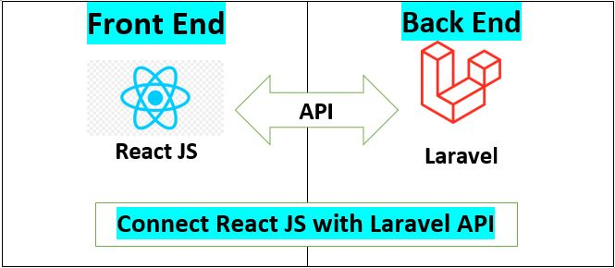
Framework Environment
php 7.4, laravel 8.0 framework for restful API and React 18.0 as frontend. Also the database will be MySql. As for creating any web based solution these are the most powerful and trendy now.

Slide 12
Technology Used
Admin Interface Design:
HTML5.0, CSS3, React JS.
Frontend and Backend Programming:
Laravel 8.0 with Restful API.
Backend Database
Mysql database.

Slide 13
Software Requirement Specification (SRS)
User Characteristics
The patient is expected to be Internet literate and be able to use a search engine. He should search the prescription link and login with his credential and just download his prescription.
The Admin is expected to be Internet literate and to be able to use email, software. He has to configure the whole system for the hospitals to make it usable for the doctors to write prescription.
The Doctors are expected to use software. So they can make the prescription for patients. They just have to entry medicine name, investigation name and advice. They also see various report. They just search them. All will be pre-configured.

Slide 14
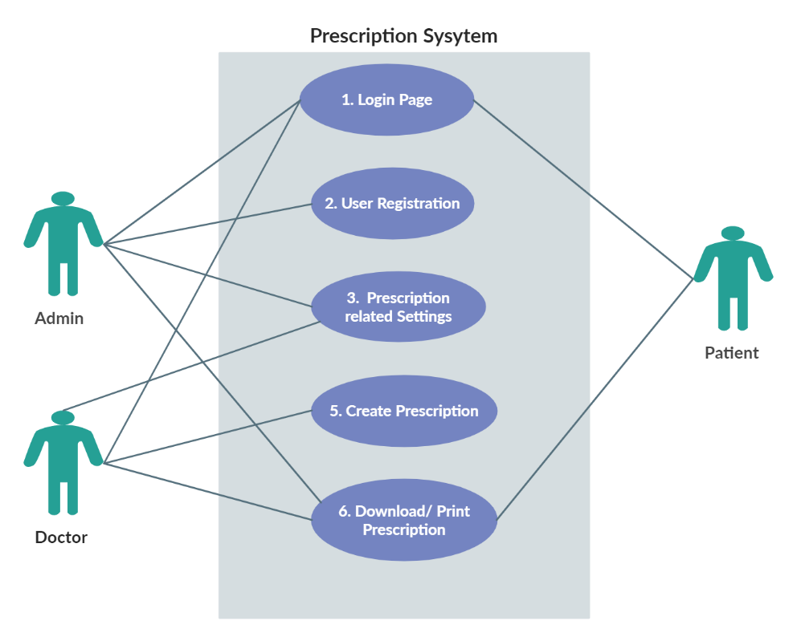
Use Case Diagram

Slide 15
System Design Model List
Model are directly related to database with admin access. To develop this site I have created some model according to functional requirement. Model list are following:-
User Model | Configuration Model | Prescription Model
User Doctor Patient | Role Chamber_Address Supplier Medicine_type Strength Department Designation Medicine Investigation Advice | Prescription Pres_Medicine Pres_Investigation Pres_advice

Slide 16
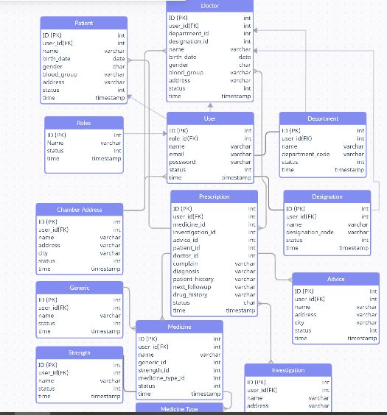
ER Diagram

Slide 17
Outline
Introduction
Background and Related Works
System Analysis & Design
Implementation and Result
Conclusion and Future Work
References

Slide 18
Hardware Requirement for React and Laravel Rest API
Required Memory: 5 GB.
Required CPU: Intel Core i3-2340UE.
Required File Size: 4 GB.
Required OS: Windows ,Linux

Slide 19
Sample Code for Rest API
Route::get('/chamberaddress',[ChamberController::class, 'index']);
Route::post('/storechamberaddress',[ChamberController::class, 'storechamber']);
Route::get('/getdepartments',[DepartmentController::class, 'allDepartments']);
Route::post('/storedepartment',[DepartmentController::class, 'storedepartment']);
Route::get('/getdesignations',[DesignationController::class, 'allDesignations']);
Route::post('/storedesignation',[DesignationController::class, 'storedesignation']);
Route::get('/getalldoctors',[DoctorController::class, 'allDoctors']);
Route::post('/addnewdoctor',[DoctorController::class, 'addDoctor']);
Route::post('/updatedoctor/{id}',[DoctorController::class, 'updateDoctor']);
Route::get('/getallpatients',[PatientController::class, 'allPatients']);
Route::get('/searchpatients/{key}',[PatientController::class, 'searchPatients']);
Route::post('/addnewpatient',[PatientController::class, 'addPatient']);
Route::post('/updatepatient/{id}',[PatientController::class, 'updatePatient']);

Slide 20
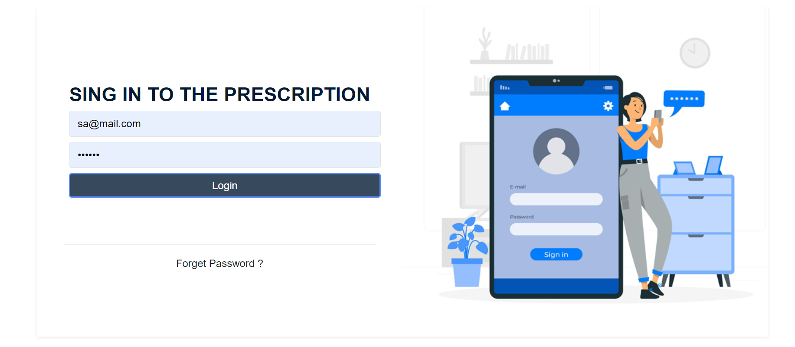
UI/UX of the project
Some important ui/ux is displayed below…
Login Page

Slide 21
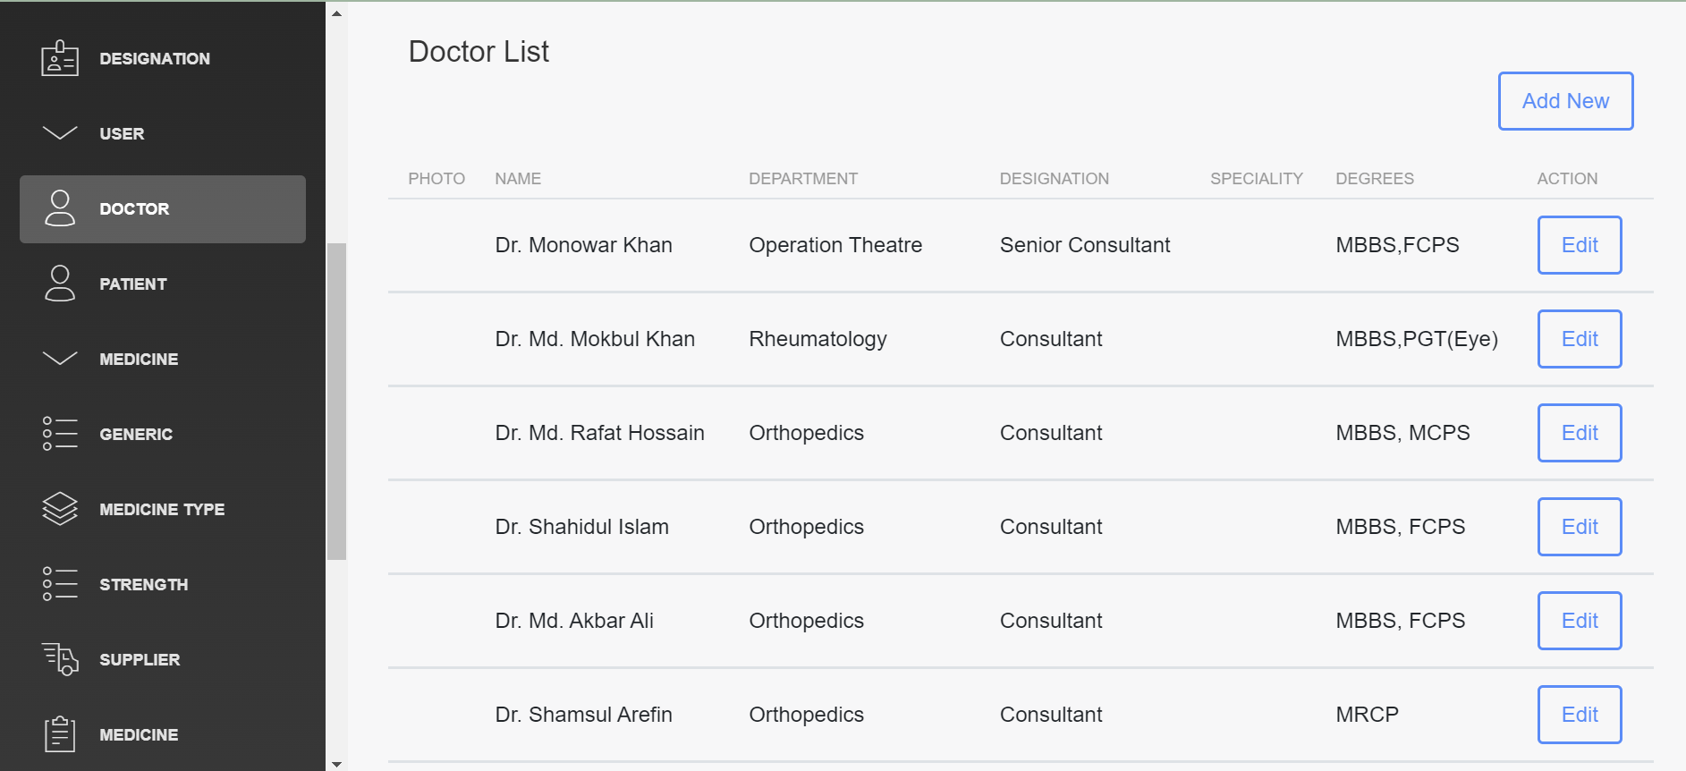
Doctor Page

Slide 22
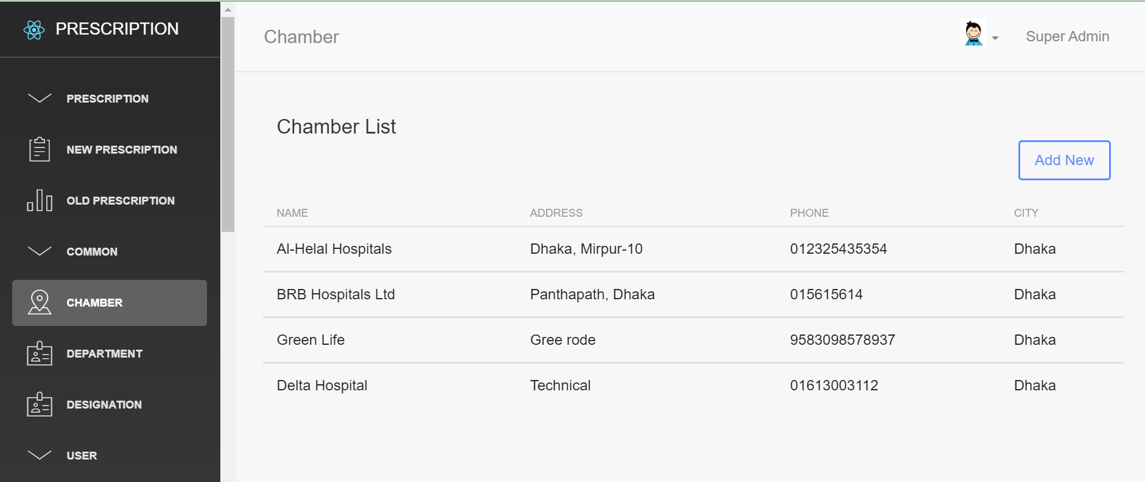
Chamber Page

Slide 23
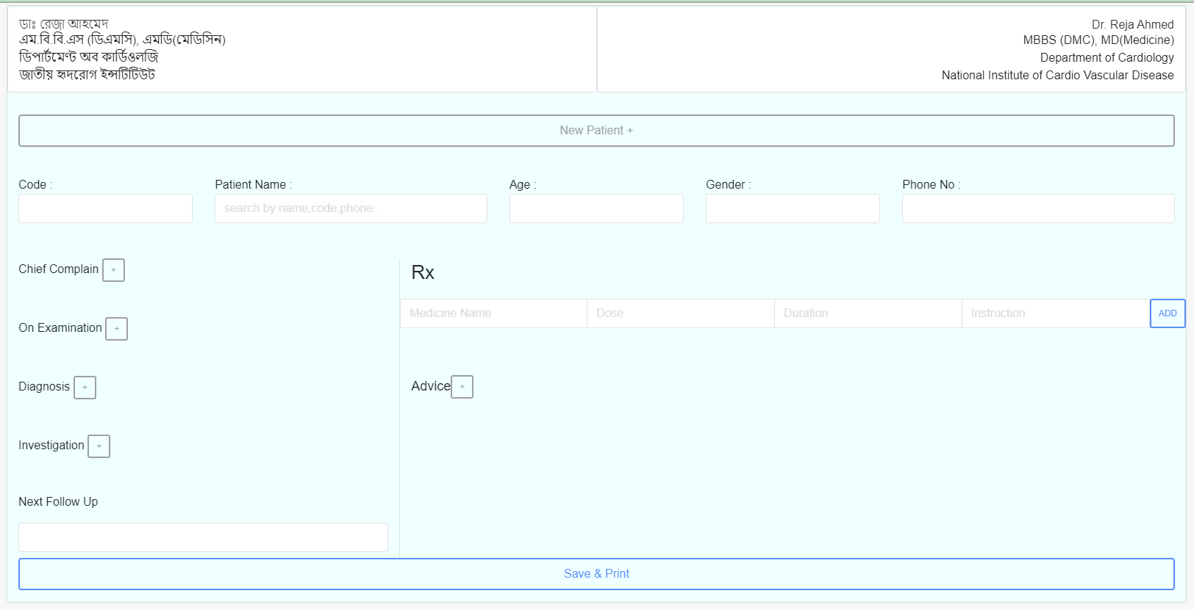
Prescription Page

Slide 24
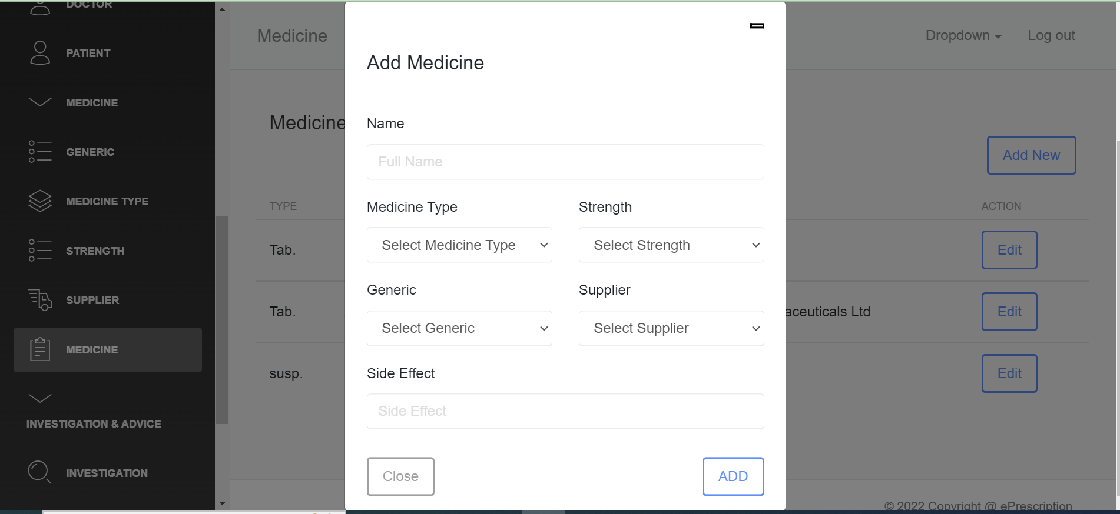
Medicine Entry Page

Slide 25
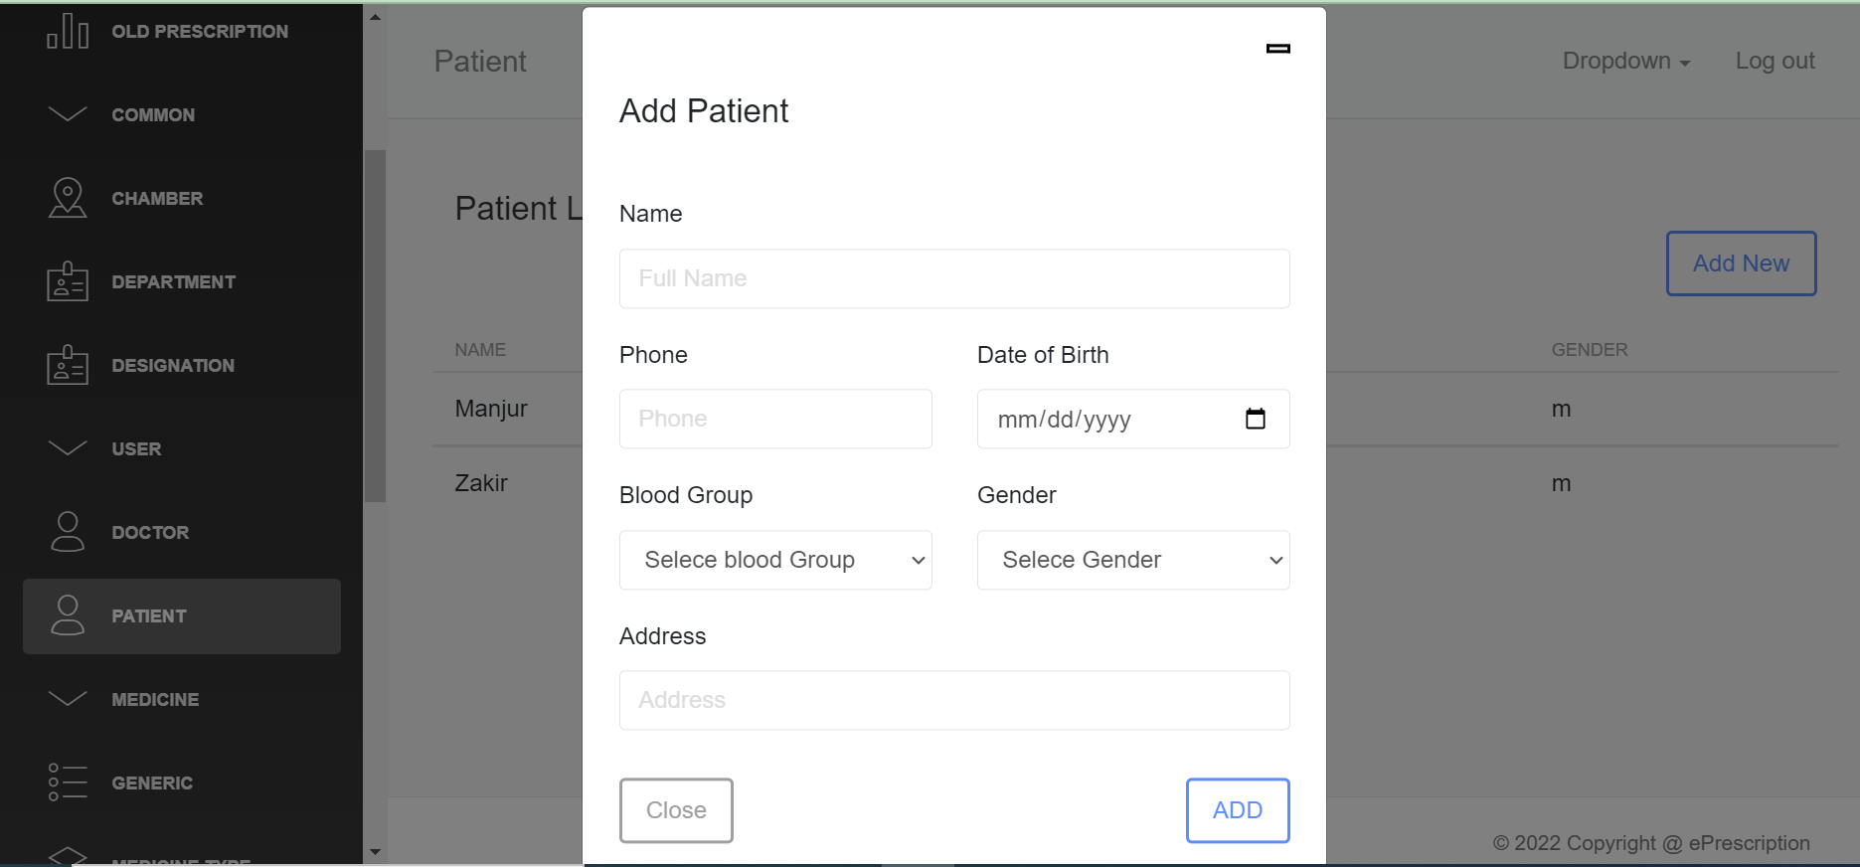
Patient Add Page

Slide 26
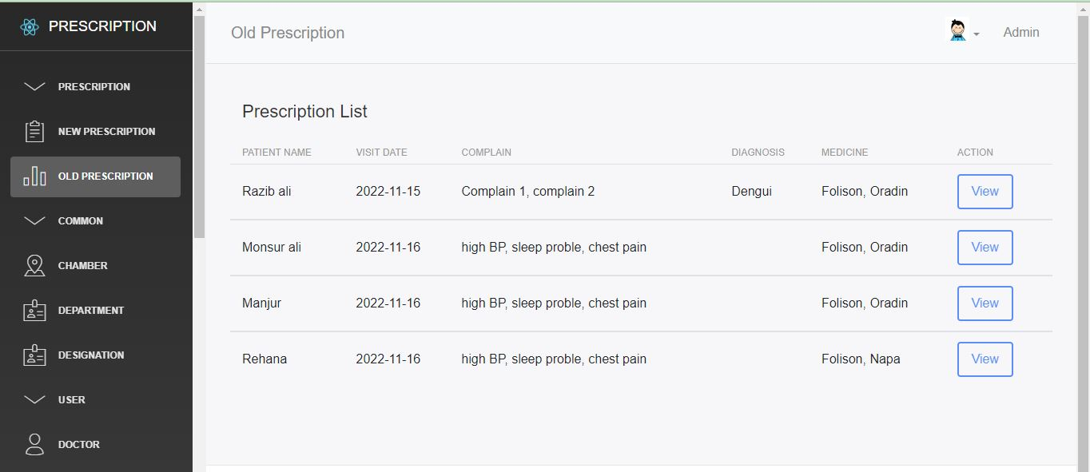
Prescription History

Slide 27
Outline
Introduction
Background and Related Works
System Analysis & Design
Implementation and Result
Conclusion and Future Work
References

Slide 28
Conclusion
I am pleased to submit the final Software documentation report on Online prescription. From this, the patients will get a clear and easy view of medicine names. To improve prescriptions efficiency, prescription is very essential. An online prescription system is more effective than paper based manual system. This document can be used effectively to maintain software development cycle. It will be very easy to conduct the whole project using it. Hopefully, this document can also help our junior BSSE batch students. We tried our best to remove all dependencies and make effective and fully designed document. We believe that reader will find it in order.

Slide 29
Future work
As this system is developed only for web system and there still lots of features to complete. So there have easy option to include any model or update. Future I will update technology and develop Mobile apps also. Besides more features will release to make it more easy and helpful for doctors. Patient dashboard will also be reach so that they can discuss with doctors with their problems.
Include huge suggestions for the doctors for medicine
Appointment Systems
Accounting for patient charge
Including Investigation result entry.

Slide 30
References
Creating use case, creately,15-11-2022, [online]. Available: https://app.creately.com/d/rWNGg4JUeCt/edit
Creating ER diagram , creately,15-11-2022, [online]. Available: https://app.creately.com/d/rWNGg4JUeCt/edit
Laravel Related Documentation, Laravel, 10-11-2022, [online]. Available: https://laravel.com/docs/8.x
React related documentation , ReactJS,09-11-2022, [online]. Available: https://reactjs.org/
Refil Prescription systems , Refil , 17-09-2022, [online]. Available: bit.ly/3GhGkDG
Pro Clinic Prescription, Pro clinic, 17-09-2022, [online]. Available: https://www.konnectplugins.com/proclinic/Vertical/index.html
Zilsoft Prescription , Zilsoft ,17-09-2022, [online]. Available: https://zilsoft.net/about/
, various ,15-11-2022, [online]. Available: https://www.softwareadvice.com/medical/e-prescribing-comparison/
IEEE Reference Format, IEEE ,15-11-2022, [online]. Available: https://ieeeauthorcenter.ieee.org/wp-content/uploads/IEEE-Reference-Guide.pdf

Slide 31
-------------- END ---------------- Thanks For Your Time

